Slide 1
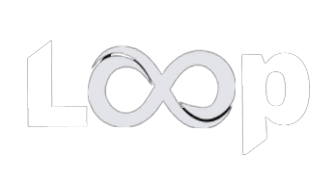
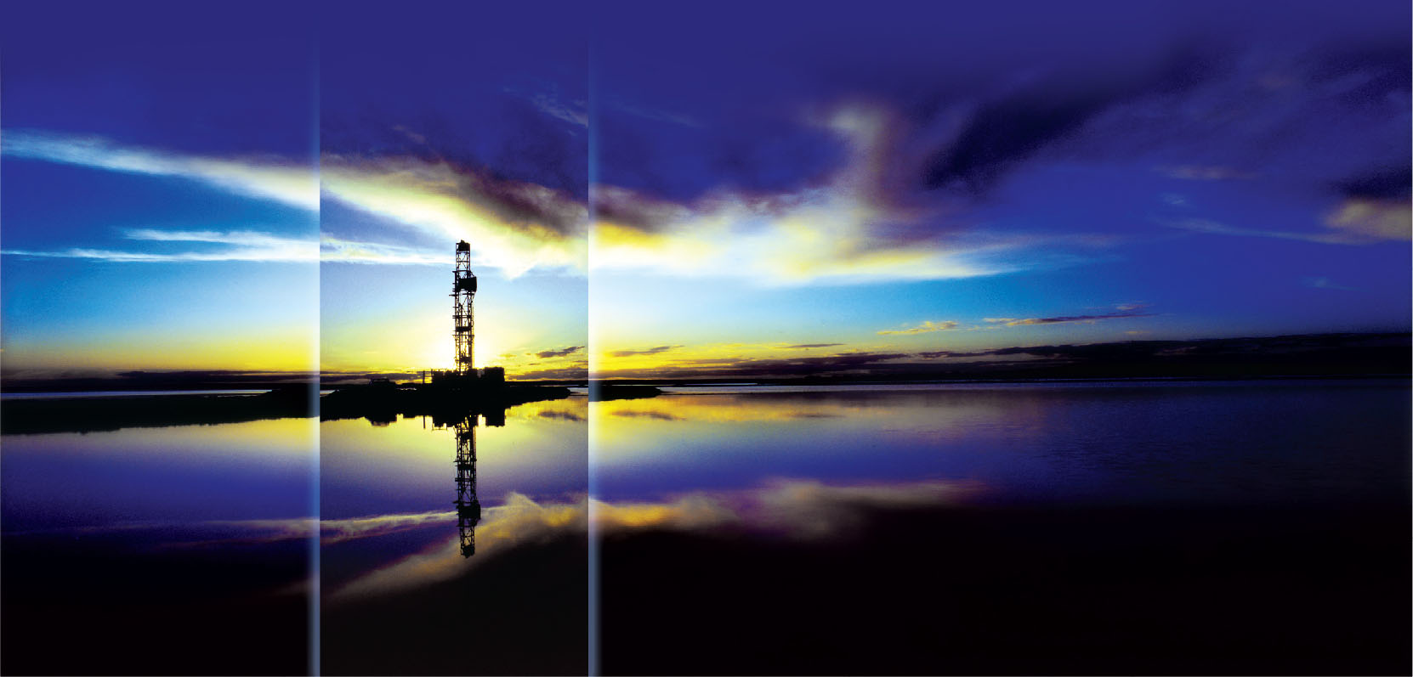



Loop ‘Flow’
Fremantle, July 23rd 2023
6ias 3D modelling and Loop workshop
Guillaume Pirot, Leonardo Portes, Mark Jessell,
Kerry Bardot & Jim McCallum
guillaume.pirot@uwa.edu.au
Notes:
The University of Western Australia acknowledges that it is situated on Noongar land, that the Noongar people remain the spiritual and cultural custodians of their land and continue to practise their values, languages, beliefs and knowledge.
Welcome……
Excuse our Director Steve who is unfortunately ill and cannot be here….
Program for today…..
Step a back a bit and tell you what we are all about……

Slide 2
















Majors, METS and Survey Participants (16)

Slide 3





















Research Participants and Affiliates (20)

Slide 4
What is LoopFlow ?
A Python package authored by Mark Jessell and Guillaume Pirot, to:
Generate graphs from Loop models
Calculate flow parameters based on those graphs
Available on GitHub:
https://github.com/Loop3D/LoopFlow
With some example Python notebooks:
one derived from ‘Draw your own model’ example (6ias map2loop workshop)
the other hardwired to loading van der Wielen et al. Emmie Bluff Gocad surfaces

Slide 5
Motivations – part 1
Understanding and Targeting Mineral Systems
Source
Path
Host
Testing different scenarios
Source locations
Potential path or barriers
Potential hosts

Slide 6
Motivations – part 2
Groundwater management
Subsurface characterization
Inverse problem
Challenging computing costs of flow and transport simulations with finite element or finite difference solvers

Slide 7
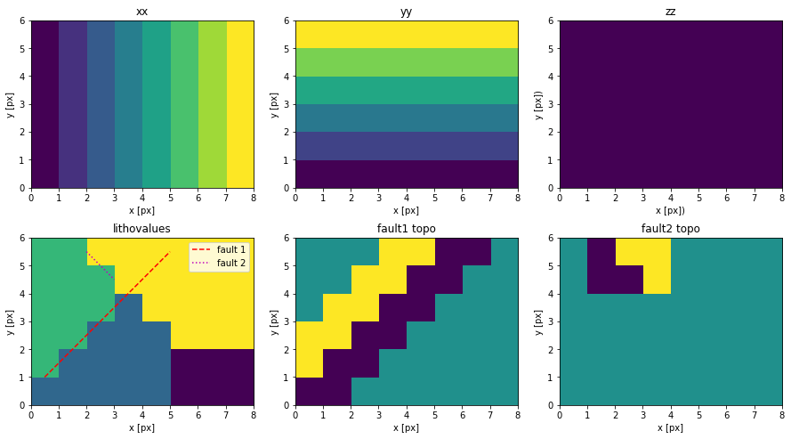
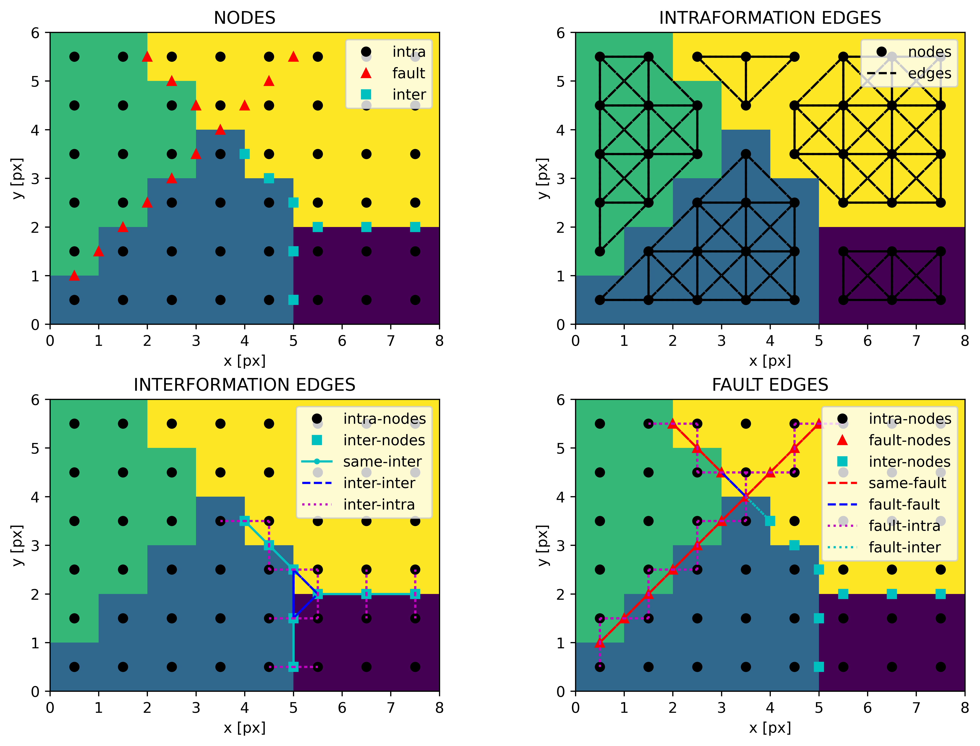
From voxet to graph
Voxet outputs from Loop Model

Slide 8
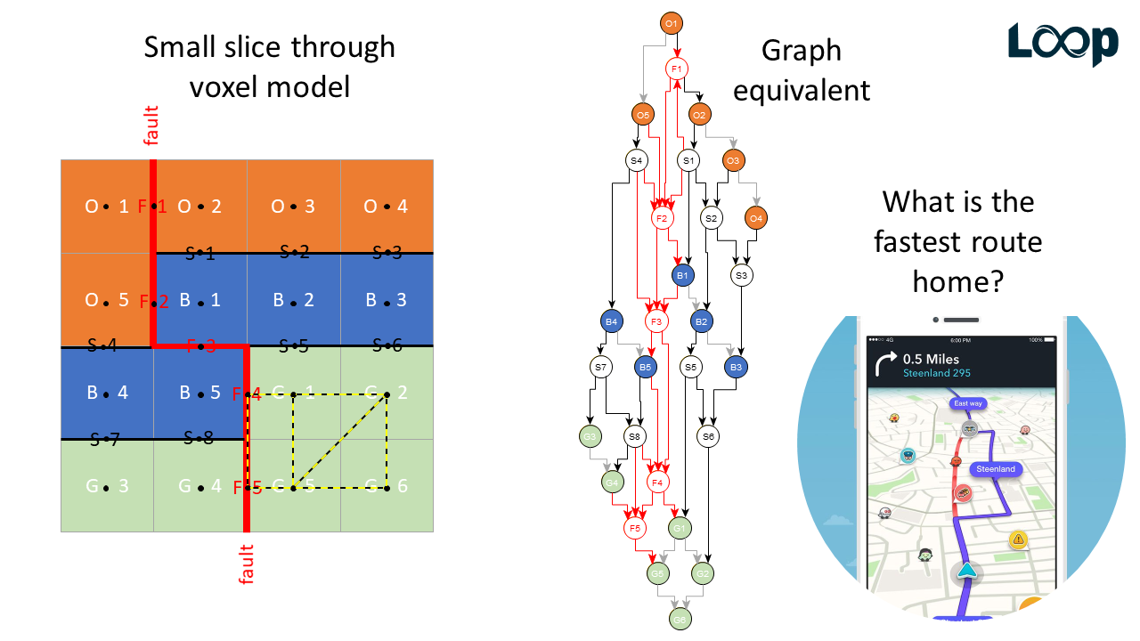
Graphs

Slide 9
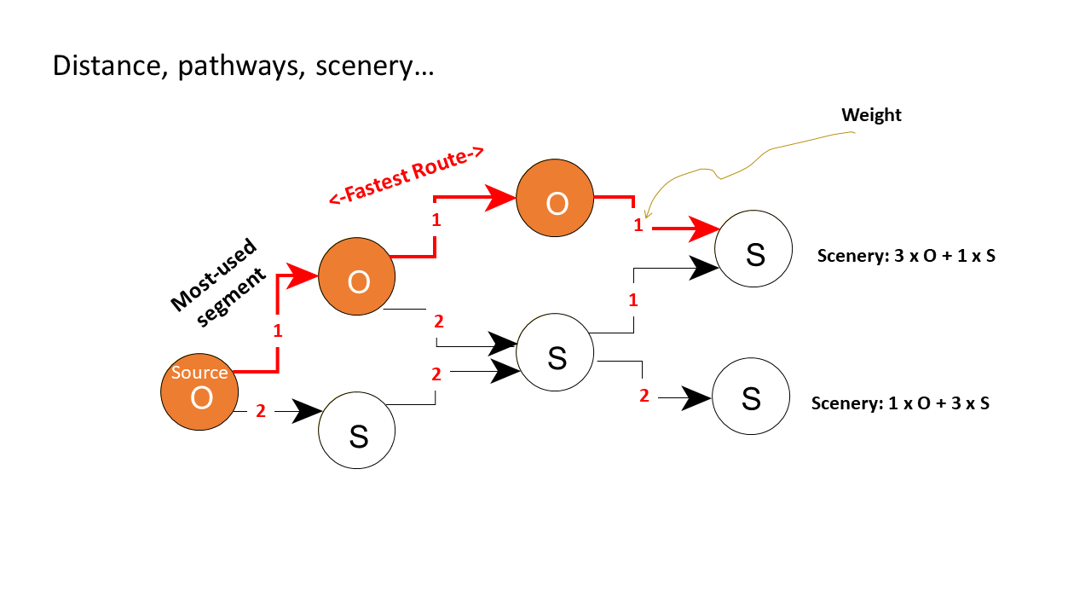
Possibilities
Does it work to approximate flow and transport
in aquifers with complex structures?

Slide 10
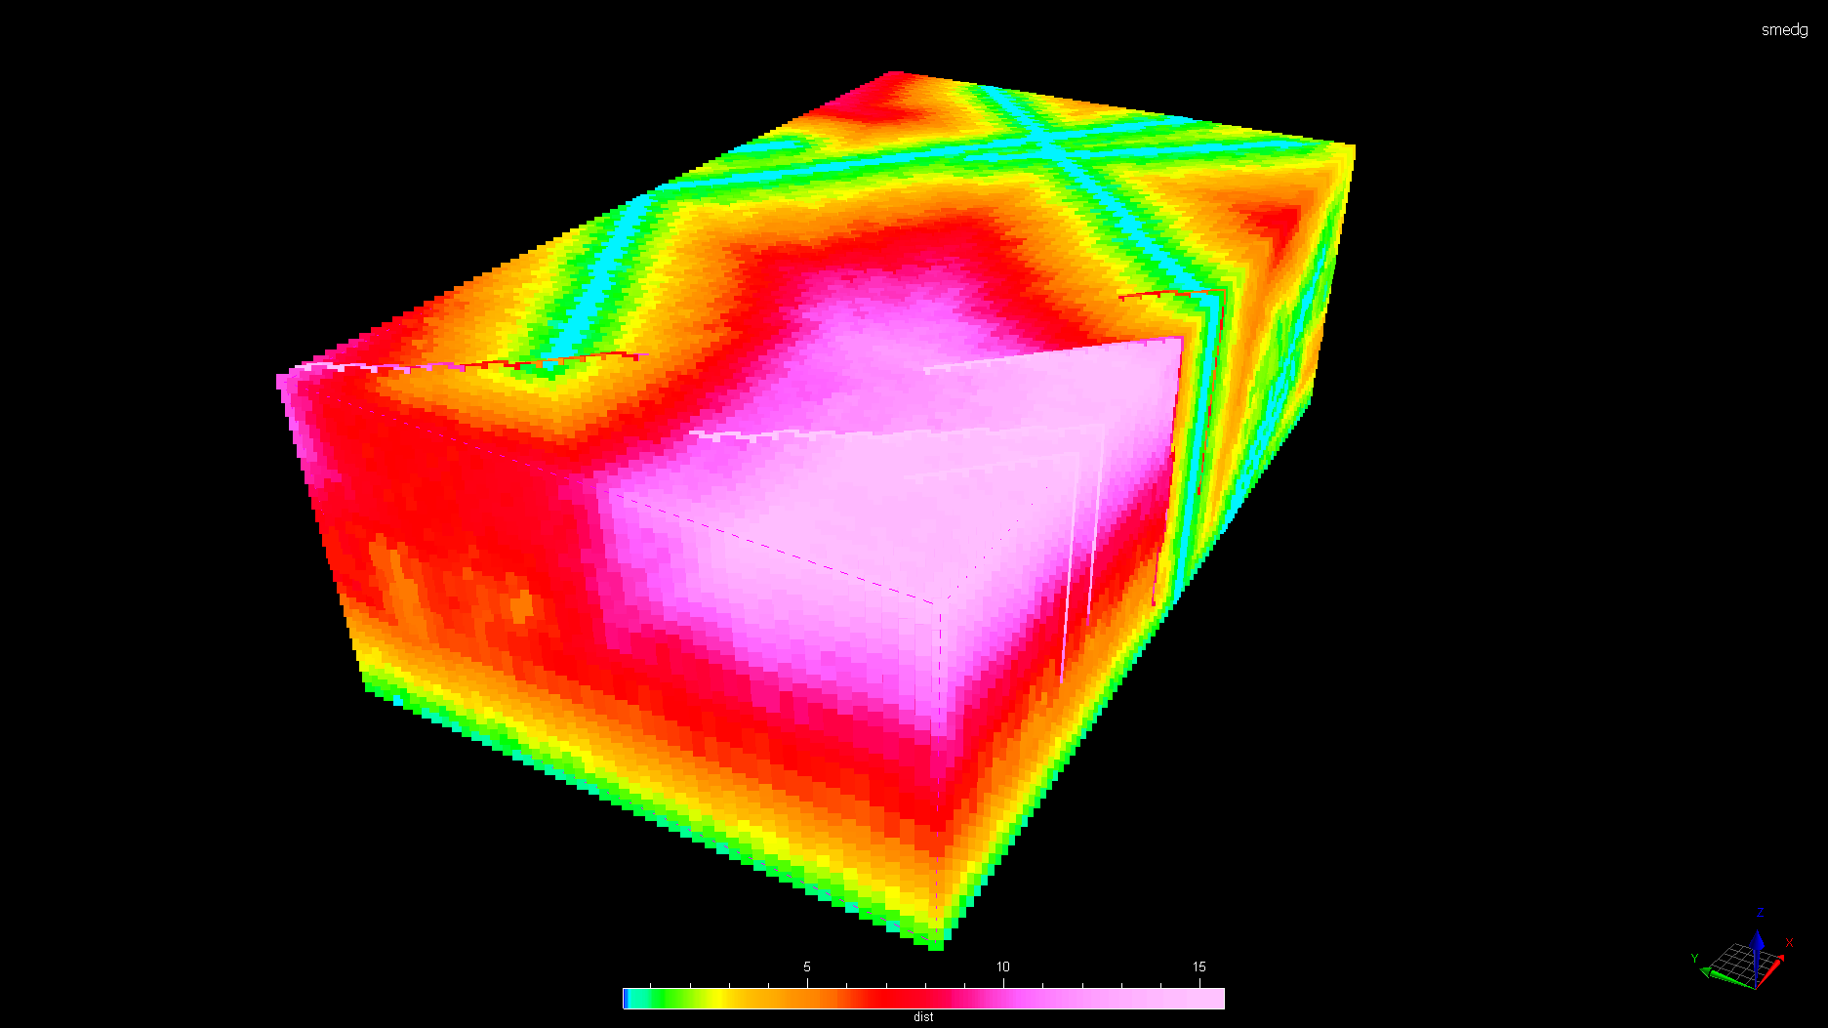
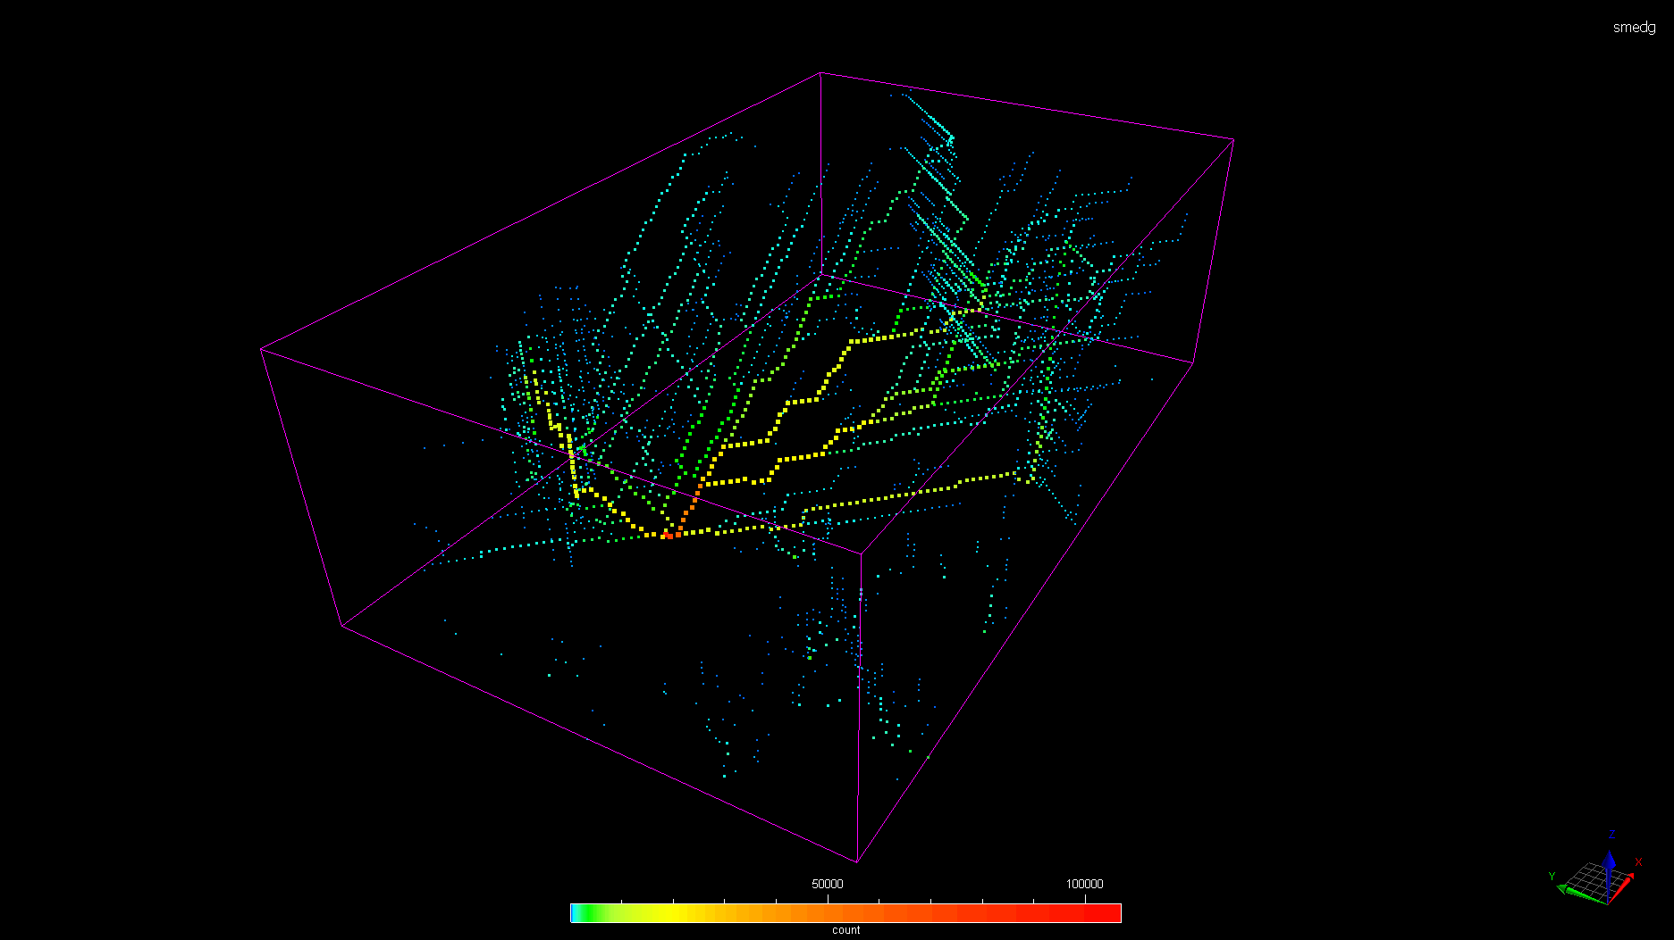
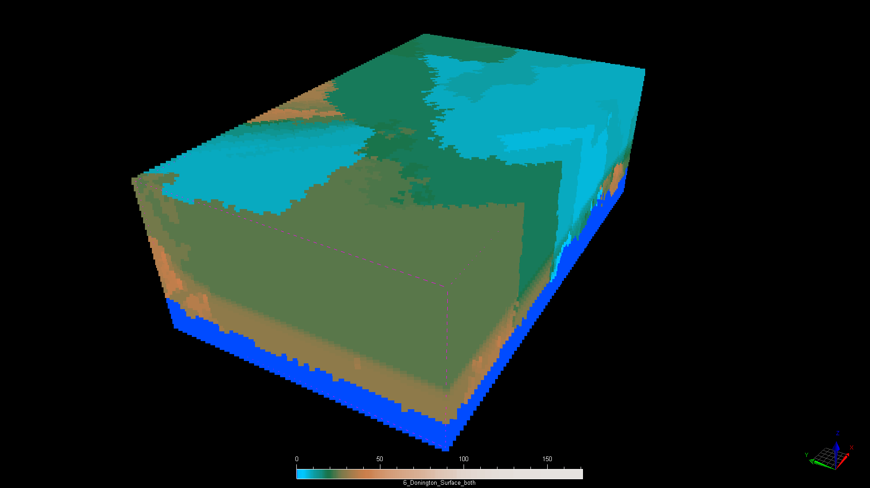
Mineral resources perspectives
Distance from source
Preferred pathways
Path scenery
Mineralization halo
Contaminant remobilization
Chemical reaction paths
Python notebook: https://github.com/Loop3D/6IAS/blob/main/LoopFlow/2_m2l_wa_flow.ipynb

Slide 11
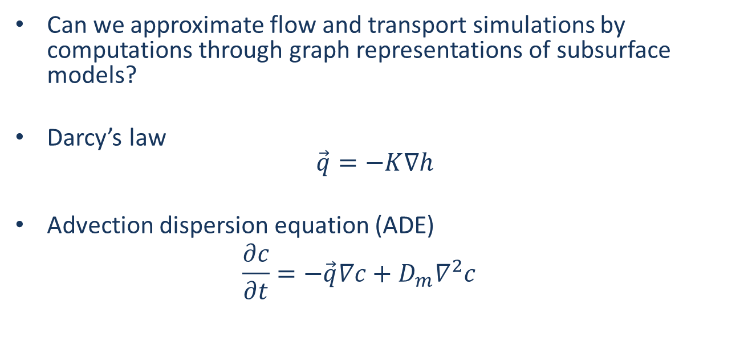
A groundwater application
Can we approximate flow and transport simulations by computations through graph representations of subsurface models?
Darcy’s law $\vec{q}=−K∇h$
Advection dispersion equation (ADE) $\frac{∂c}{∂t}=−\vec{q}∇c+D_{m}∇^{2}c$
advection
diffusion

Slide 12
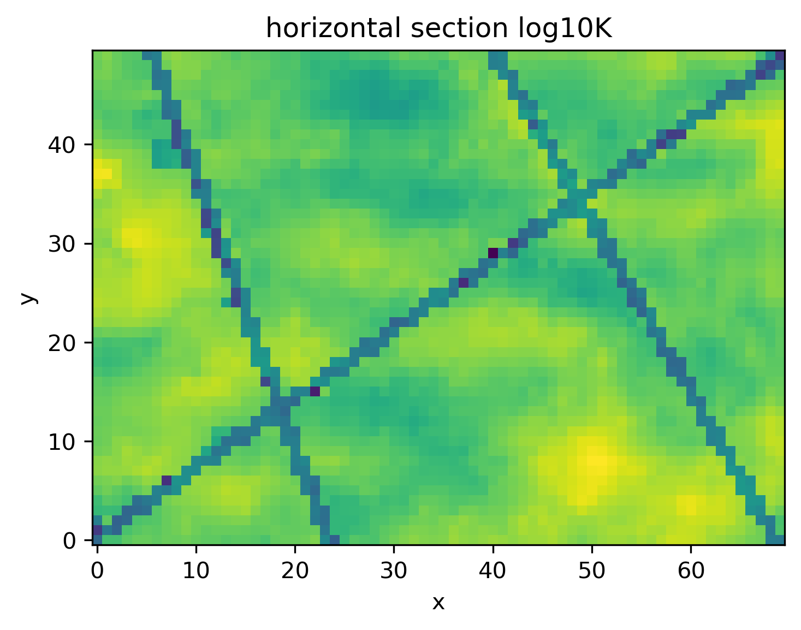
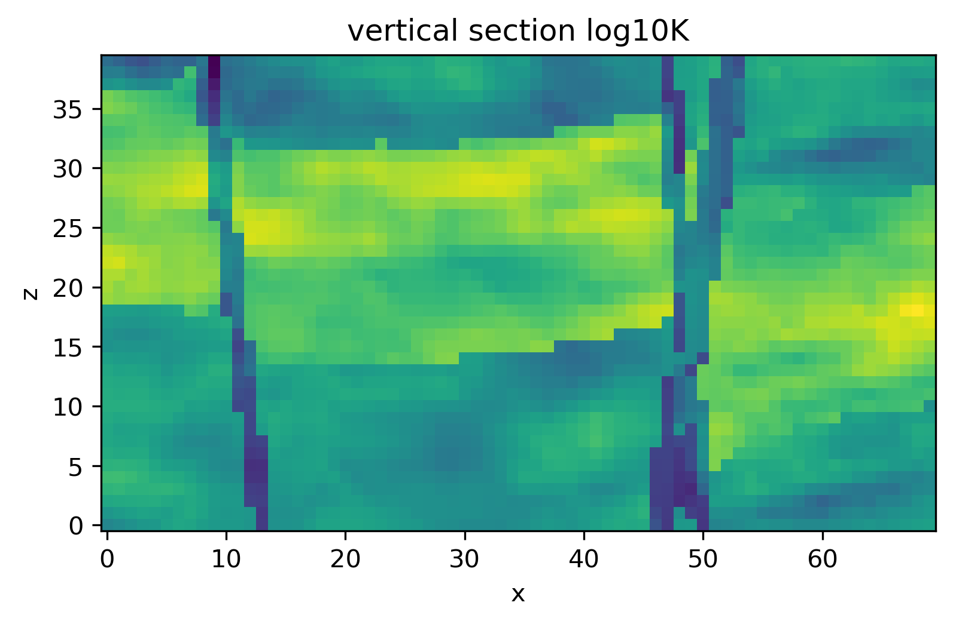
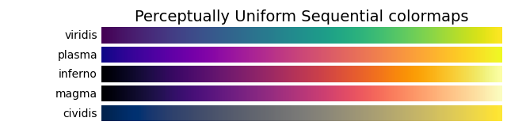
Experimental setting
7km x 5km x 1km (x-axis,y-axis,z-axis)
70 x 50 x 40 cells
3 heterogeneous stratigraphic units
3 faults (fixed geometry)
5
1
Y (km)
Z (km)
Log K (m/d)
0
0
0
X (km)
7
0
X (km)
7

Slide 13
Scenarios & boundary conditions
3 faults paths or barriers
2³ = 8 possibilities
ꟷ path log₁₀K +2
ꟷ barrier log₁₀K -2
∆ injection well
x
y
Scenario 0
Head = 100m
Scenario 1
No flow
Scenario 2
Fault 1
General flow direction
Scenario 3
Fault 2
Scenario 4
Head = 0m
No flow
Fault 3
Scenario 5
Scenario 6
Steady state flow
Transient transport, advection and diffusion
10 years of simulation (timestep = 1 month)
Scenario 7

Slide 14
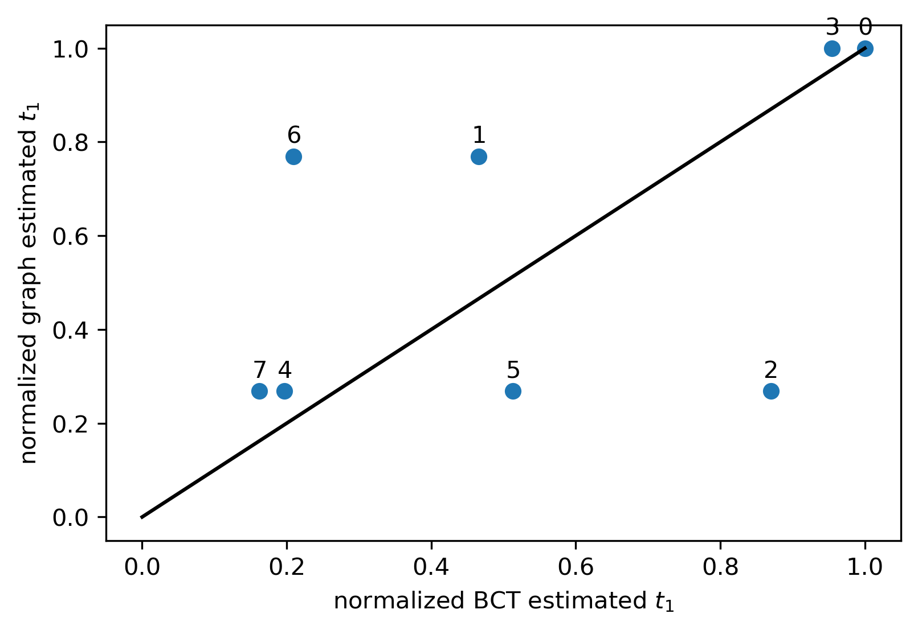
First arrival travel times
Fault 2 & 3 barriers
Fault 2 barrier
Scenarios {0,…,7}
ꟷ path
ꟷ barrier
Fault 2 path
Fault 3 most influential, then Fault 2 then Fault 1

Slide 15
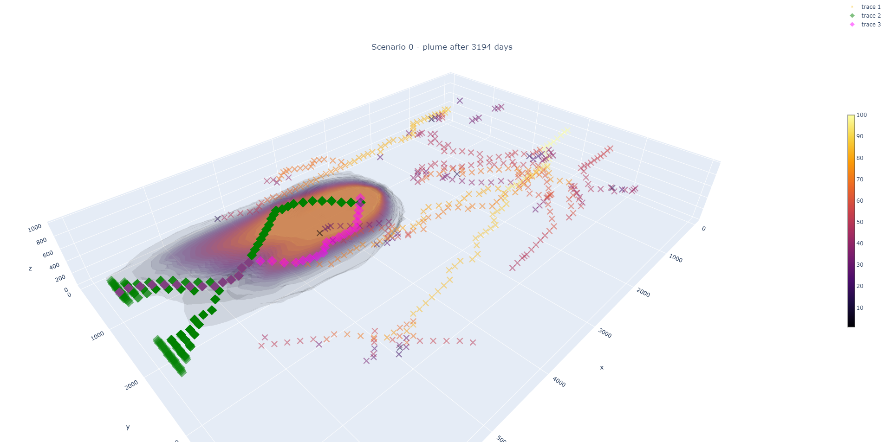
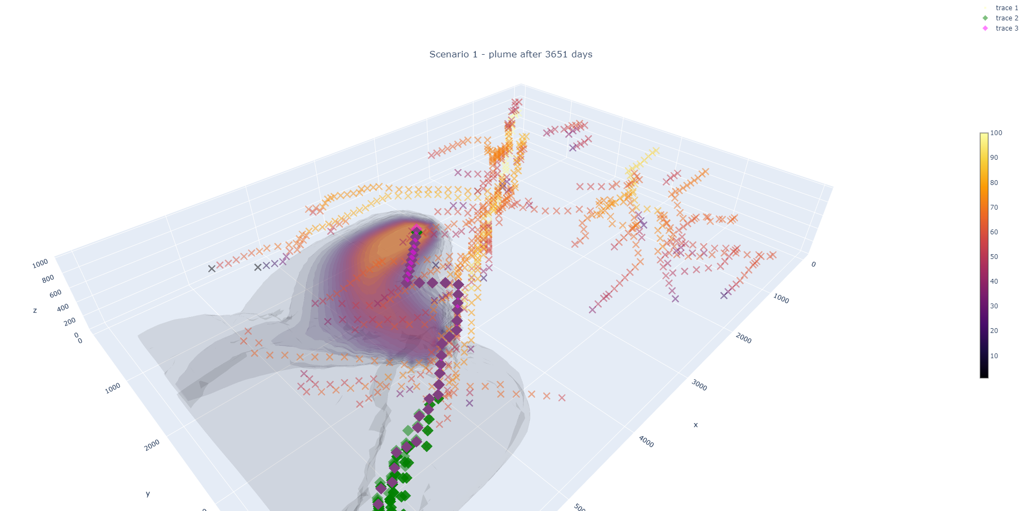
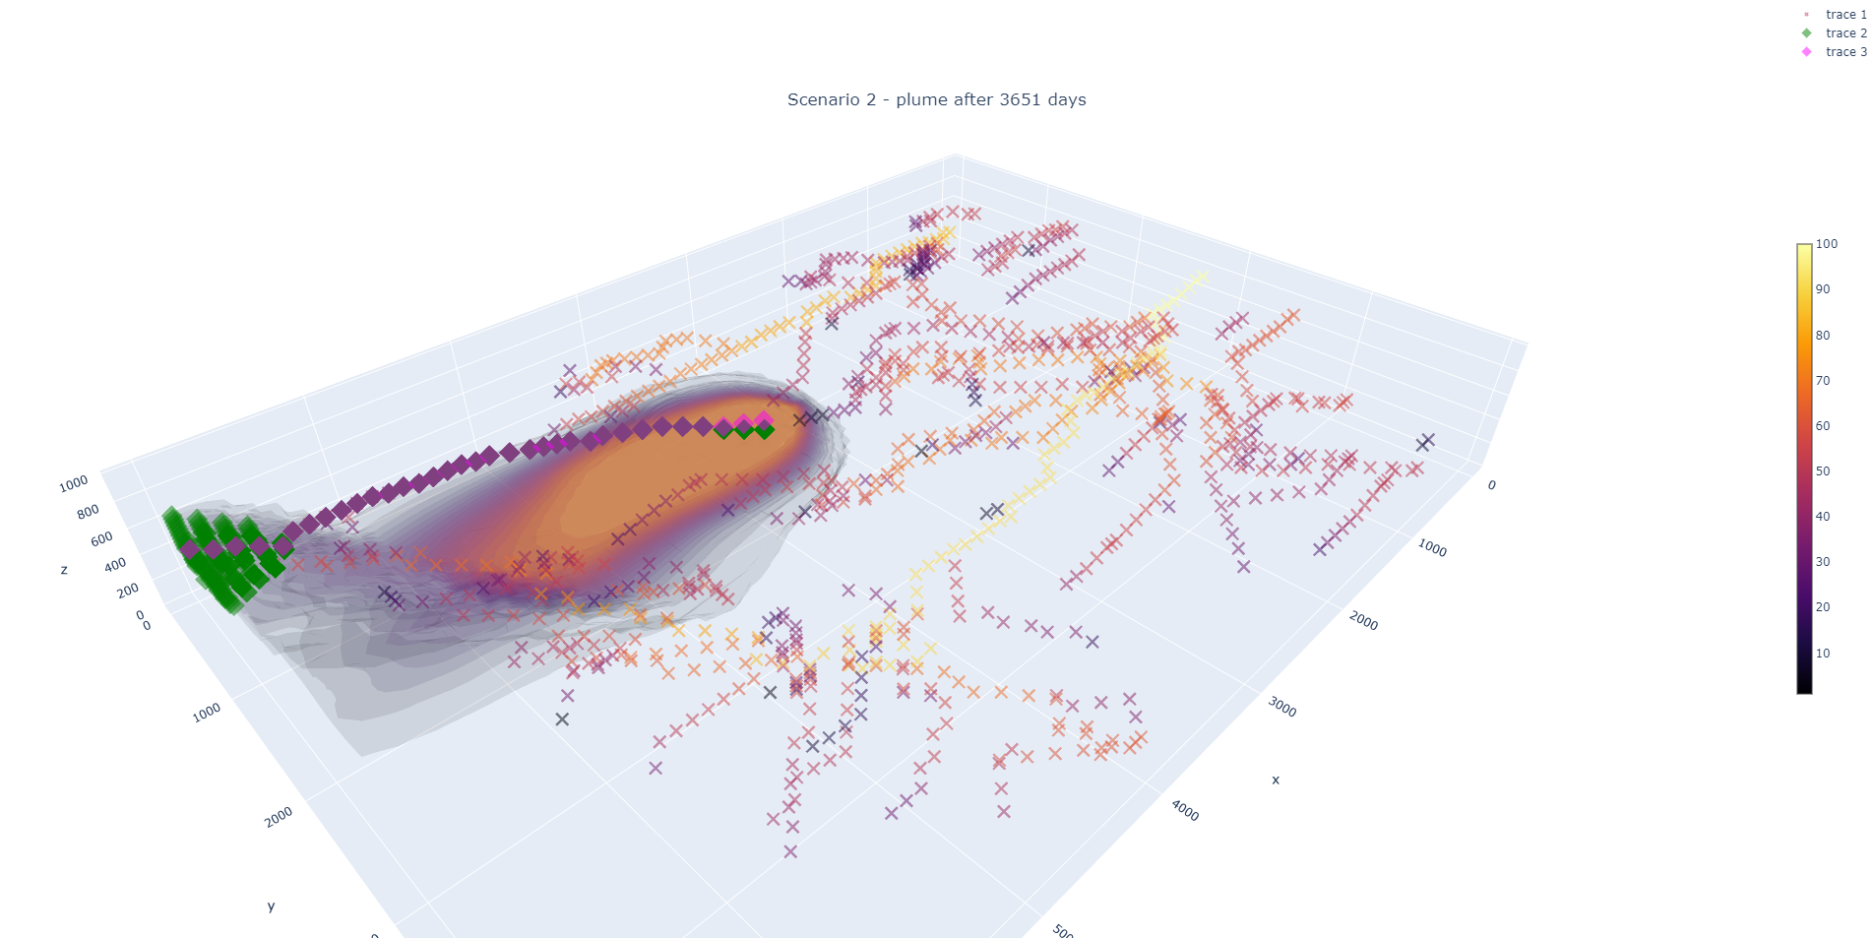
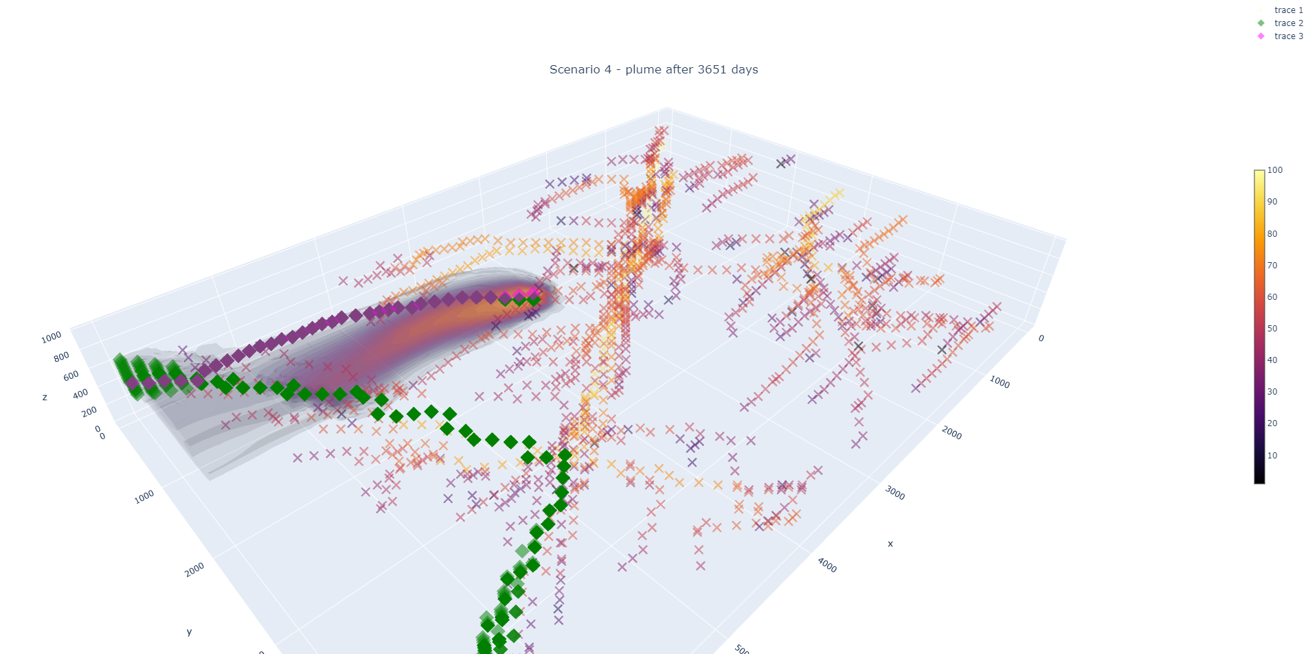
Transport results
50 best paths outlets
Scenario 0
Scenario 1
backward path outlet
Z
Z
X
X
Y
Y
Modflow6 concentrations
Scenario 2
Scenario 4
Z
Z
X
X
Y
Y

Slide 16
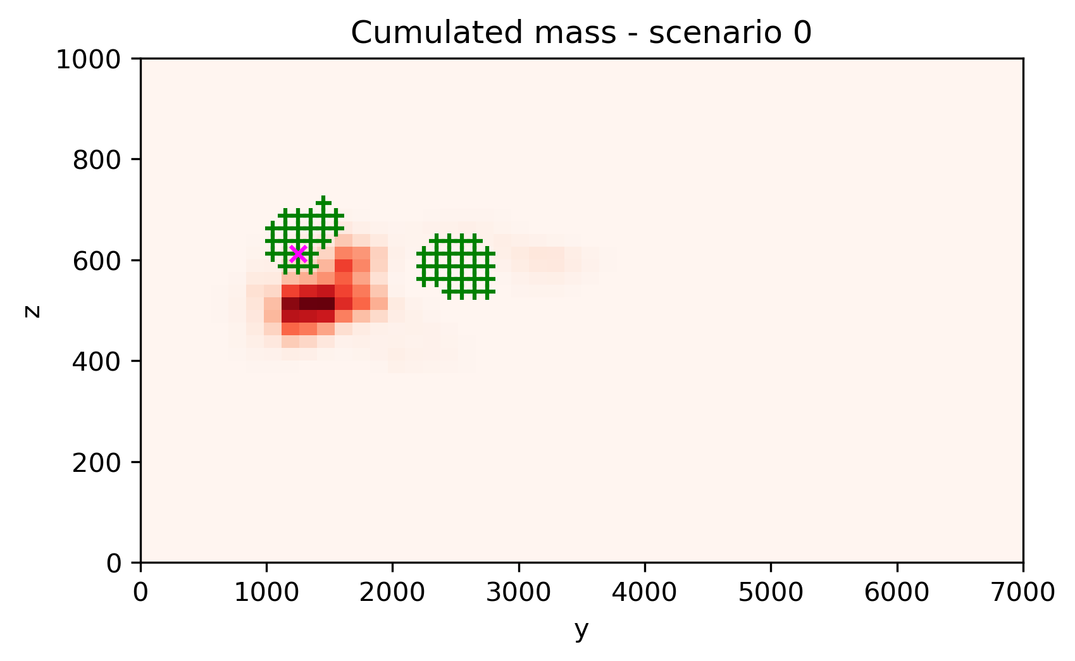
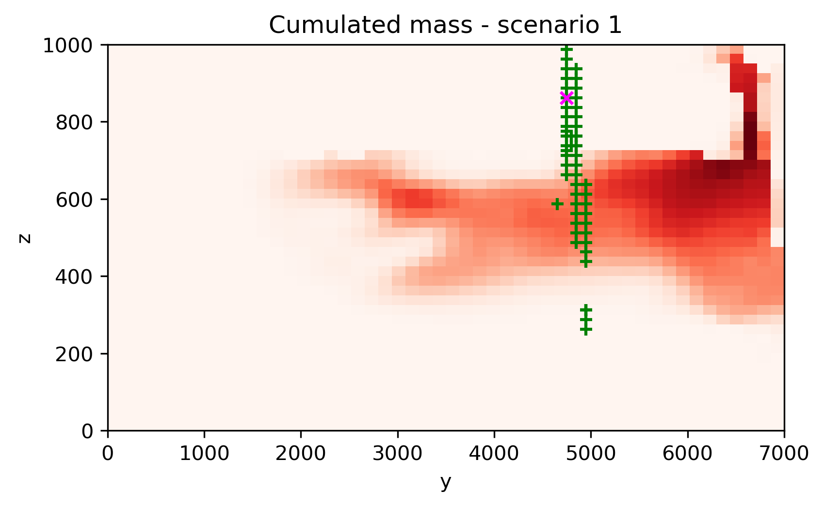
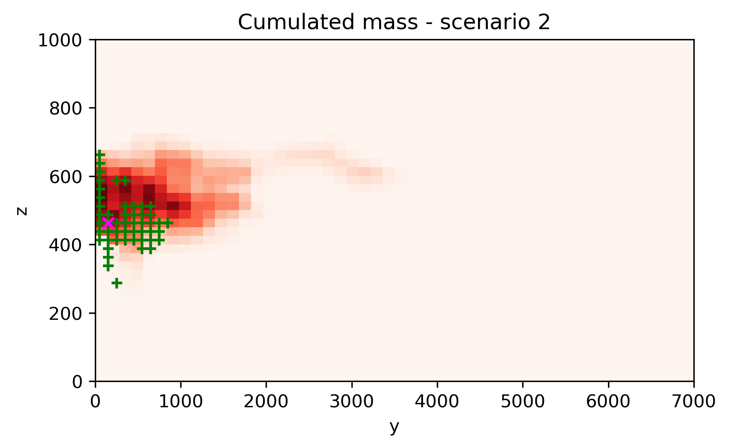
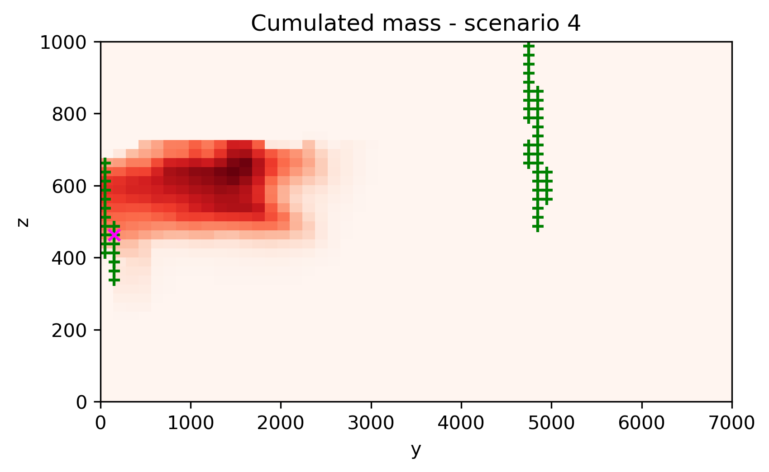
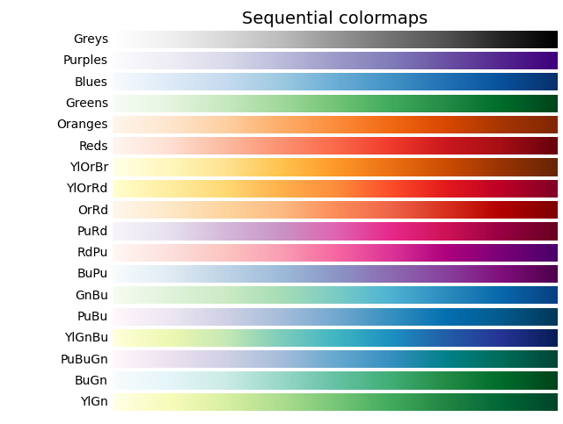
Transport results
+
50 best paths outlets
x
backward path outlet
cumulated mass
from Modflow6

Slide 17
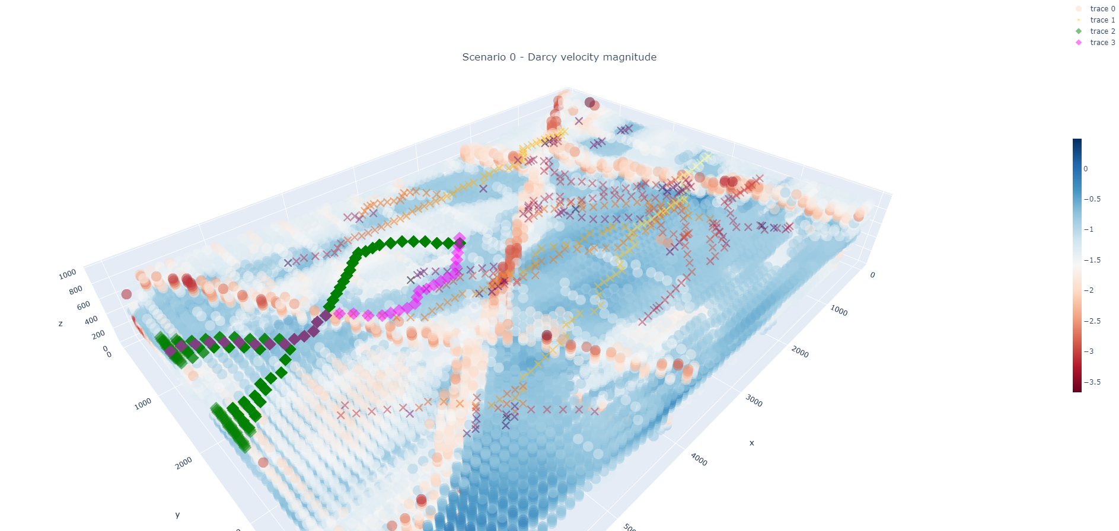
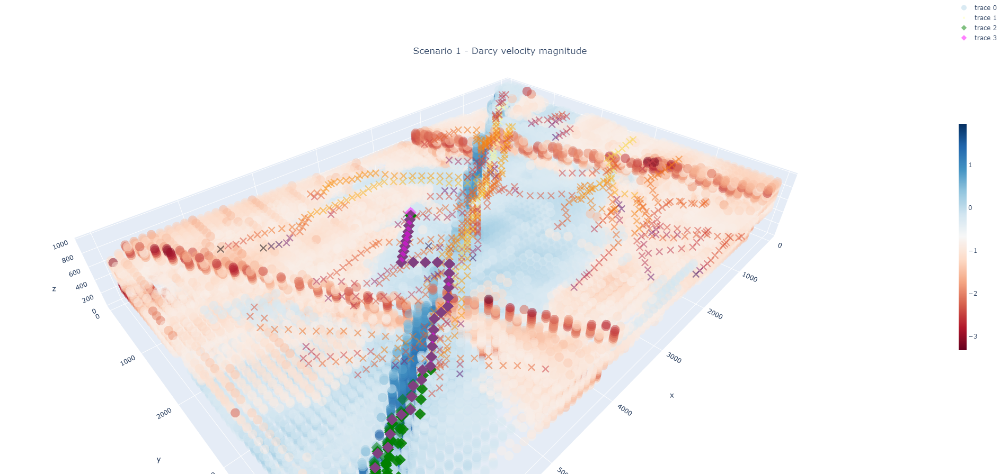
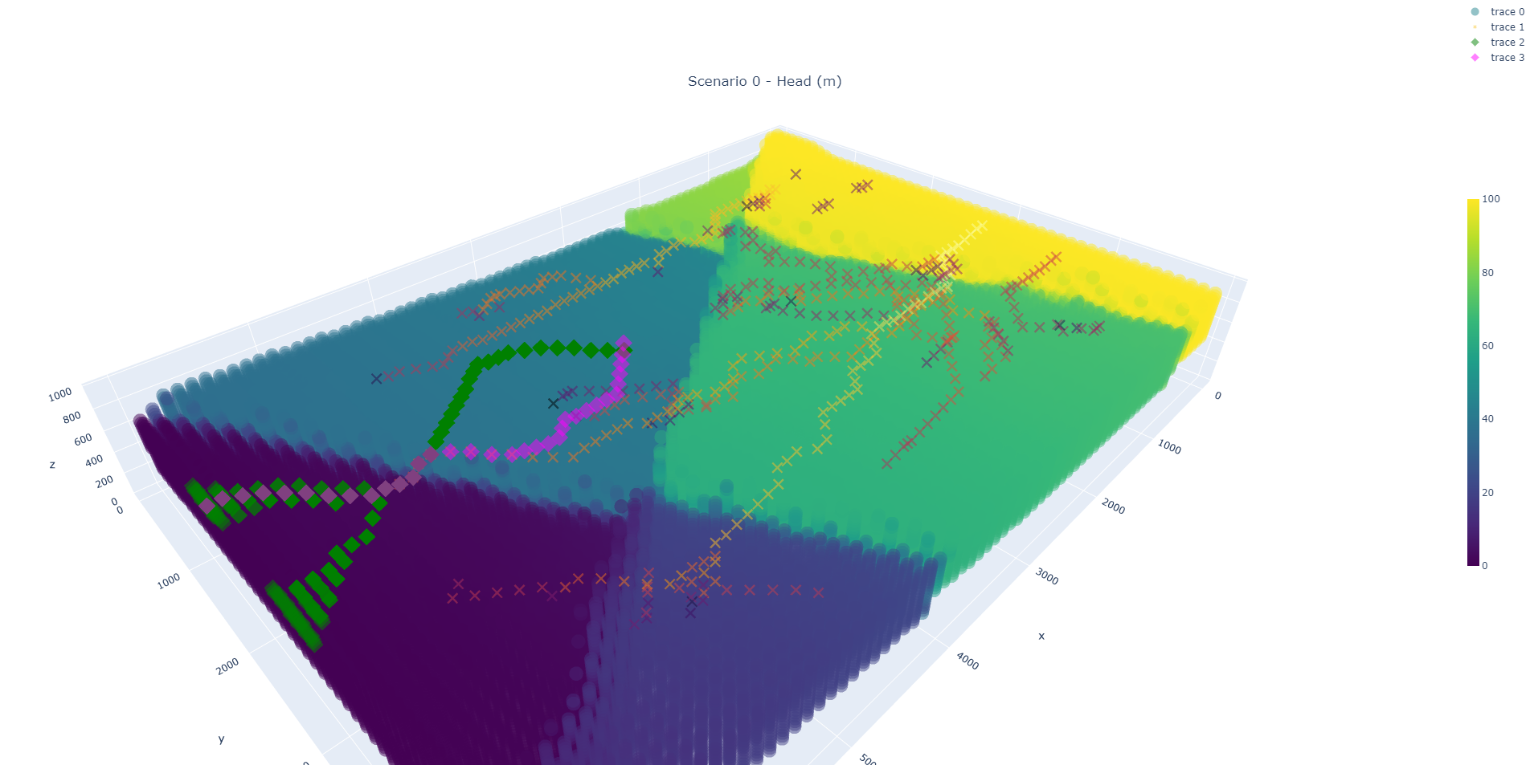
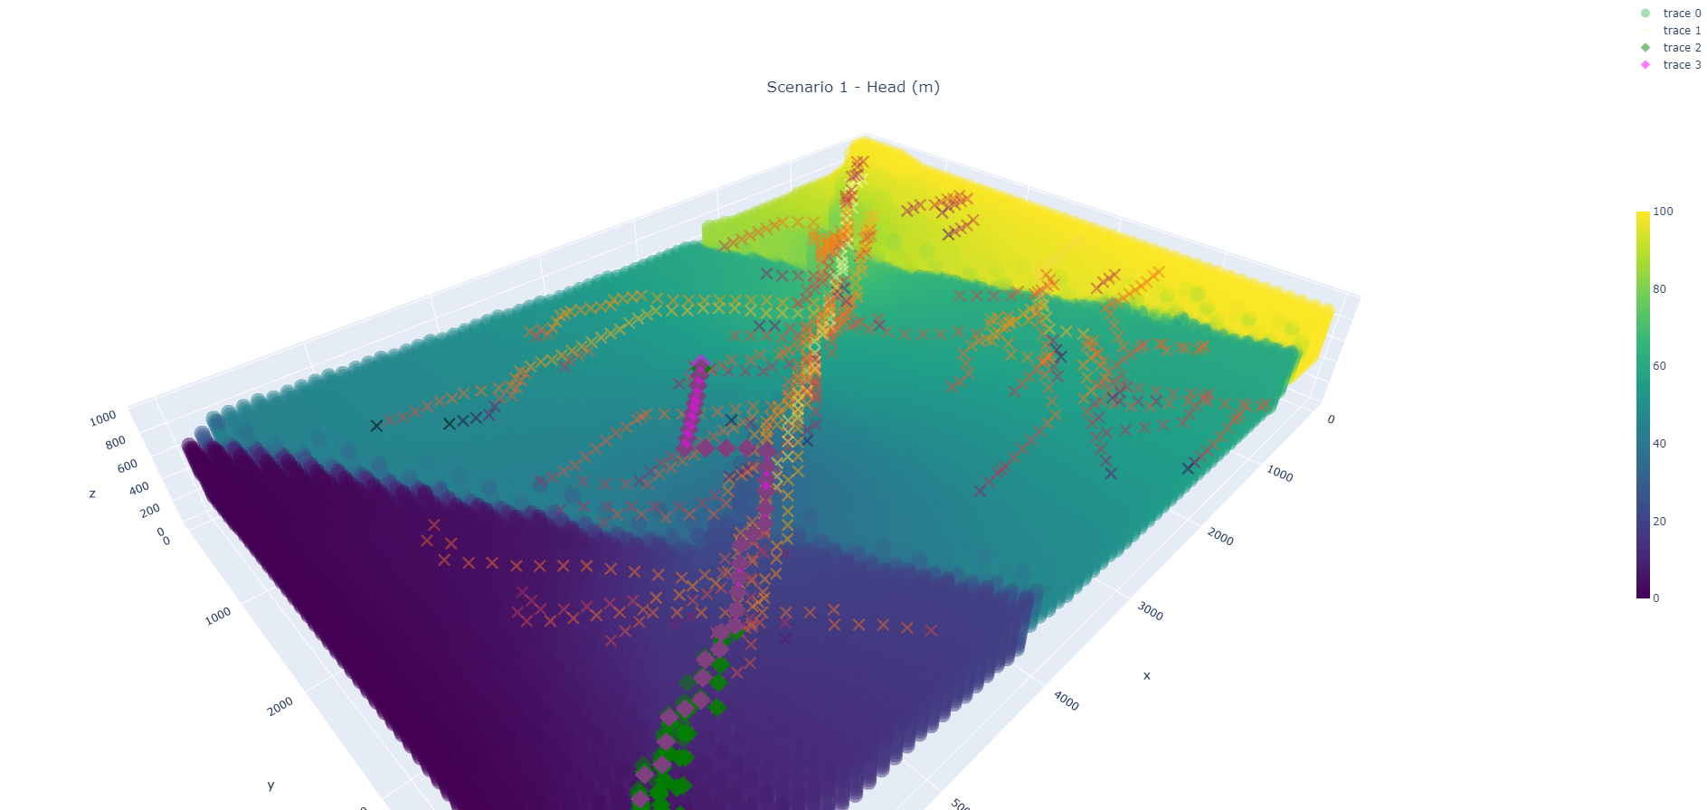
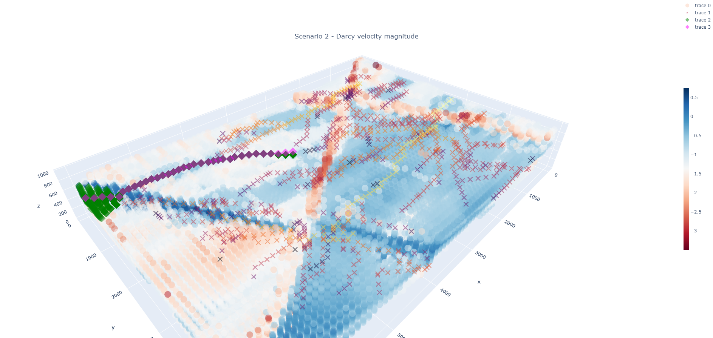
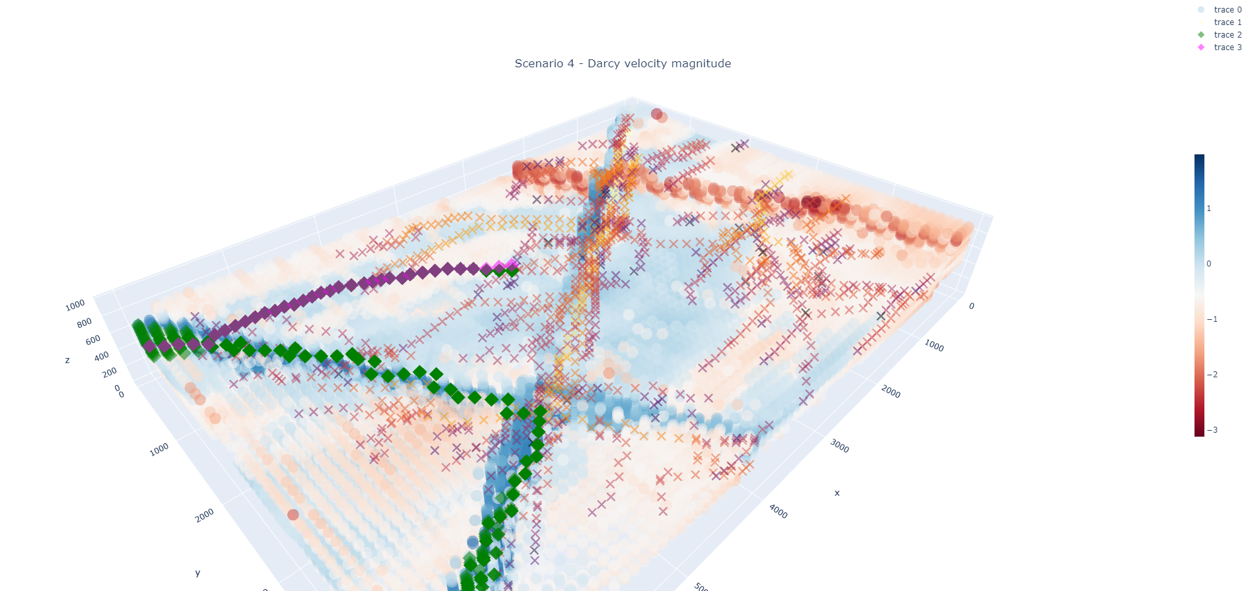
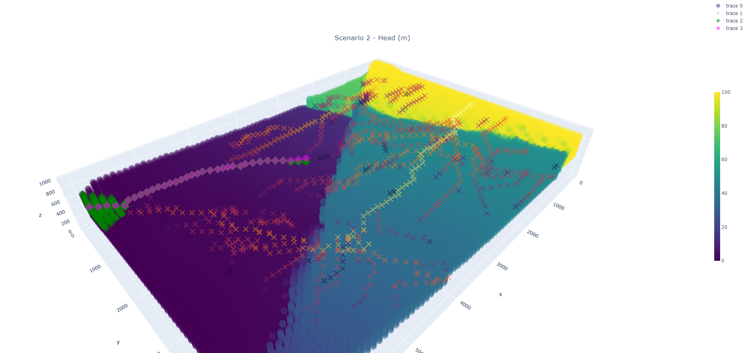
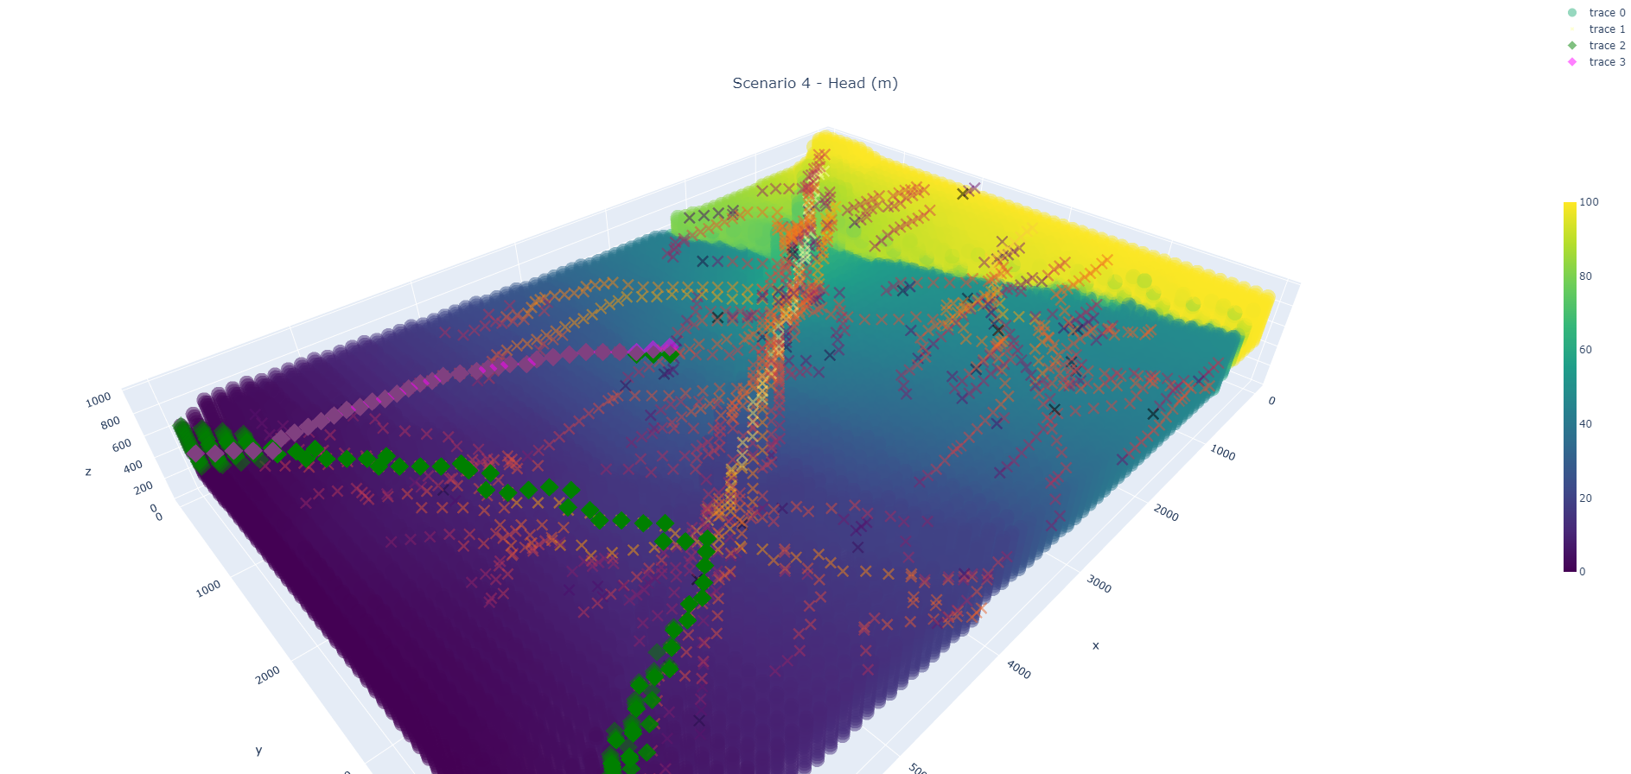
Flow results
50 best paths outlets
Scenario 0
Scenario 1
backward path outlet
Z
Z
X
X
Y
Y
Modflow6 log Darcy velocities (m/d)
Scenario 2
Scenario 4
Z
Z
X
X
Y
Y

Slide 18
Computing requirements
From an existing voxet model (140k cells)
Using Python libraries networkx and flopy
Graph generation: ~30 seconds per graph
Backward or forward distances from graphs: ~ 3 seconds per computation
Modflow6 simulation (1 steady state + 120 timesteps for a total of 10 years): ~ 5 minutes per simulation

Slide 19
Groundwater application summary
Graph approximations are blind to upstream flow conditions
Backward path approximation seems more accurate
Cumulative mass outlet locations are relatively coherent
Least resistant paths are consistent with the field of Darcy velocity magnitudes

Slide 20
Future work
Graph weight tuning
First arrival time calibration
Find alternative paths to see if we can approximate the plume shape
What if we used the velocity field rather than the K field to build a graph
Comparison with particle tracking simulations
Unstructured mesh to better explore fault effects
Ideas for other applications and collaboration?

Slide 21
THANK YOU
guillaume.pirot@uwa.edu.au

Slide 22
Detailed parameters
Upper hydro stratigraphic unit log₁₀K
µ = -4.45 m/s
σ = 0.4 m/s
Middle hydro stratigraphic unit log₁₀K
µ = -3.10 m/s
σ = 0.5 m/s
Lower hydro stratigraphic unit log₁₀K
µ = -4.69 m/s
σ = 0.6 m/s
K_{xx}=K_{yy}=10K_{zz}
Porosity: 25%
Q_{well} = 50∙10³ m³/d
α_{L} = 1 m (longitudinal dispersivity)
α_{T} = 0.1 m (transvers dispersivity)

Slide 23
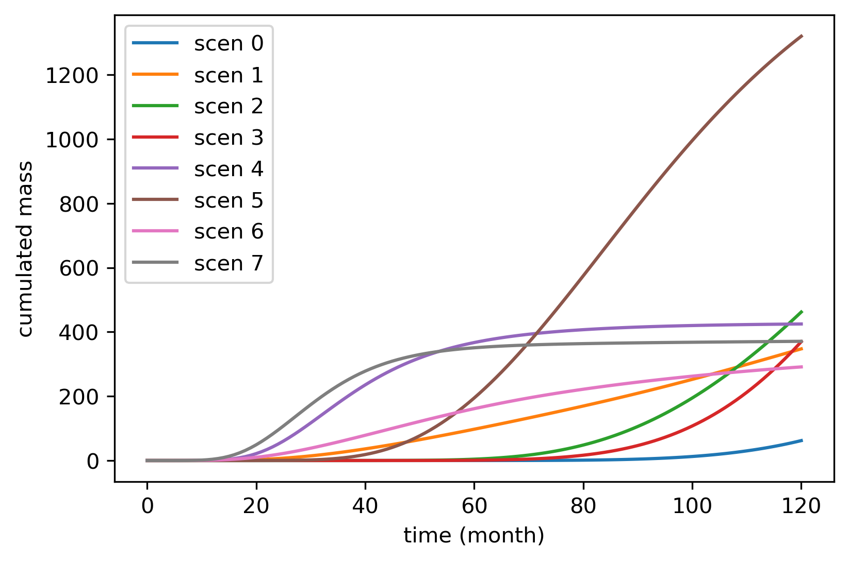
Estimation of first arrival travel time from breakthrough curves
t1 scenario 5

